Slide 1
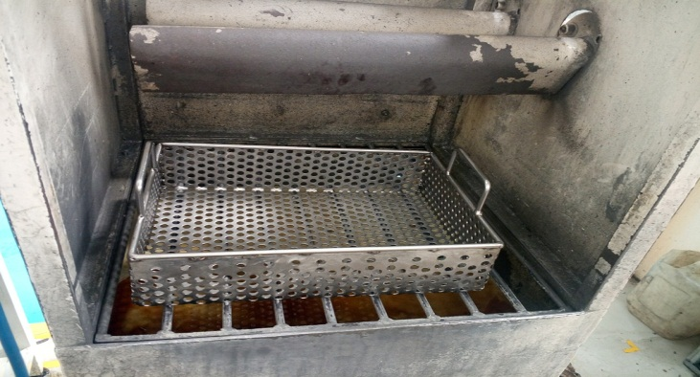
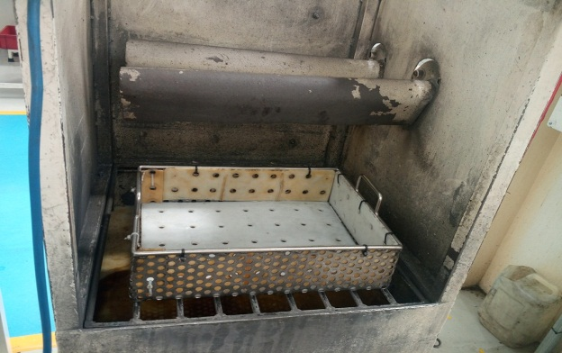
AHPL/QMS/FR/09/E
P15
KAIZEN NO :-
ACTIVITY
KK
QM
PM
JH
SHE
OT
DM
E&T
KAIZEN IDEA SHEET
TPM CIRCLE NAME:
LOSS NO. / STEP
DEPT :- MACHINE SHOP
RESULT AREA
P
Q
A,B,C
C
D
S
M
CELL:- Grinding
CELL NAME:- Rotor cell
MACHINE / STAGE : Vibro machine
OPERATION :- Air cleaning and anti rust oiling
KAIZEN THEME : To Reduce Rejection for Dent Damage.
IDEA :- Vibro machine output material store in plastic coating tray.
Problem / Present Status :-
In Vibro machine output rotor get damage due to handing in metal tray.
COUNTERMEASURE:- Vibro machine output rotor handing in plastic tray. Plastic tray used for cleaning and anti rust oiling process material movement.
BENCHMARK
Avoid dent damage
TARGET
Reduce dent rejection
KAIZEN START
21.05.2017
TDC
29.05.2017
KAIZEN FINISH
29.05.2017
TEAM MEMBERS : 1.Sandip Jagtap.
2.Santosh Deshmukh.
BENEFITS :-
1. Reduce dent damage rejection .
Before
After
KAIZEN SUSTENANCE
WHY - WHY ANALYSIS :-
Why1 :- Rotor get damage during loading and unloading in metal tray.
Why2:- due to metal to metal contact rotor get damage.
Why3 :- Metal tray used.
RESULT :-
Avoid rotor dent during loading and unloading.
Reduce dent damage rejection.
WHAT TO DO:- Vibro machine output metal tray covered with plastic .
HOW TO DO:- Waste plastic material used for metal tray covering.
ROOT CAUSE :- Vibro machine output rotor handle in metal tray.
REGISTRATION NO. & DATE :
SCOPE & PLAN FOR HORIZONTAL DEPLOYMENT
REGISTERED BY :- Sandip Jagtap.
SR.
NO.
CELL
TARGET
RESPONSIBILITY
STATUS
MANAGER’S SIGN :- D. Y. Pawar
1
All tray
15.06.16
Sandip Jagtap
Pending
Rev. no: 01 Rev . Date:15.12.2016

